Slide 1
WEB Programming
By : Tamal Dey
Assistant Professor,
Dept. of MCA, PESU

Slide 2
JavaScript
Overview of JavaScript
Object Orientation and JavaScript
General Syntactic Characteristics
Primitives, Operations and Expressions
Screen Output and Keyboard Input
Control Statements
Object Creation and Modification
Arrays
Functions
Constructors
Pattern Matching using Regular expression
Errors in Scripts

Slide 3
Overview of JavaScript
JavaScript was originally named LiveScript, which was developed by Netscape
In late 1995 Netscape and Sun Microsystems change it’s name to JavaScript
ECMA(European Computers Manufacturers Association) given latest version 3 that can be shown in Firefox browser 2 and IE 7.
The standard for JavaScript is found in
http://www.ecma-international.org/publications/standards/Ecma-262.htm

Slide 4
Introduction
JavaScript is the scripting language for the Web
JavaScript improves the design, validate forms, detect browsers, create cookies etc.
Java Script is supported by browsers like Internet Explorer, Mozilla, Firefox, Netscape, and Opera
Java script is divided into 3 parts:
Core: Heart of language include operators, expression, statements, sub-programs
Client side: Supports the objects that supports the browser. E.g. mouse event, keyboard input,
Server side: Supports objects that make language useful in web server E.g. Communication with DBMS

Slide 5
Introduction -JavaScript
Scripting language
Text based technology
Interpreted language
Runs inside the web page in the browser
Enables to enhance static web pages by providing following
Dynamic, personalized, and interactive web content
Examples
Flashy drop down menus, Moving texts, images
Continuously changing contents
Google docs, calendar etc
It has become default language of choice for web contents

Slide 6
JavaScript and Java
They are very different in respect to OOP
Object model of java script in different from Java
JavaScript does not support OOP paradigm
Java data members and methods are static and fixed in compile time but JavaScript objects are dynamic, the number of data members can change during runtime
JavaScript is not a OOP language but an Object-based language. It has no class, inheritance and polymorphism
Similarity between Java and JavaScript is the syntax of expression, assignment statement and control statements

Slide 7
Java vs. JavaScript
Java is strongly typed language
Types are all known at compile time, and operand types are checked for compatibility.
Variables in JavaScript need not be declared and are dynamically typed, making compile-time type checking impossible.

Slide 8
Uses of JavaScript
JavaScript is dynamically typed
JavaScript can be used to replace some of what is typically done with applets (except graphics)
Computation capability for client side
Database access, networking for server side
User interactions through forms are easy
The Document Object Model makes it possible to support dynamic HTML documents with JavaScript

Slide 9
Event-Driven Computation
User interactions with HTML documents in JavaScript use the event-driven model of computation
User interactions with form elements can be used to trigger execution of scripts

Slide 10
HTML / JavaScript
HTML document does not include embedded script, the browser reads the line of the document and renders its window according to the tags attributes and content it finds
When JavaScript is encountered in the document the browser use a JavaScript interpreter to execute the script
When end of the script reached , browsers goes back to HTML document and displaying its content
JavaScript Can appear in any of the part (Head/ Body) of HTML document depending on the purpose of the script

Slide 11
Object orientation and JavaScript
JavaScript is NOT an object-oriented programming language
Does not support class-based inheritance it has prototype-based inheritance, which is much different
Cannot support polymorphism
JavaScript objects are collections of properties, which are like the members of classes in Java and C++
JavaScript has primitives (mathematical expression) for simple types
The root object in JavaScript is Object – all objects are derived from Object
All JavaScript objects are accessed through references

Slide 12
JavaScript Objects
Objects are collection of properties
Data
Function or Method
Data has two categories
Primitive values
References to other objects
JavaScript use non-object types for simplest data types called primitives. This helps faster operation of values
In JavaScript variables that refer to an object are often called objects rather than references
myCar.engine

Slide 13
General syntax &Comment line
<script type = “text/javascript” src= “xxx.js”>
</Script>
Indirect method of embedding JavaScript in XHTML document has the advantage of hiding the script from the browser user
Semicolon (;)
Optional
//Single Line Comment
/* Multiple line Comment */
Green-red-bg.html // dynamically changing properties

Slide 14
Example
<html>
<body>
<script type = "text/javascript">
document.write("Hello World!“+”<br />”);
document.write(“Welcome to JS!“+”<br />”);
</script>
</body>
</html>

Slide 15
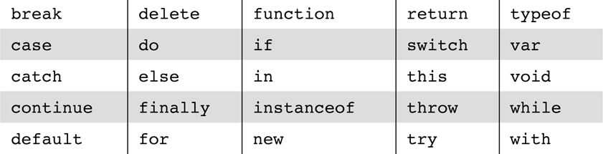
JavaScript Reserved Words

Slide 16
Primitives
JavaScript has 5 primitive types:
Number
String
Boolean
Undefined
Null
Number, String, Boolean(True/False) objects are called wrapping object because they provide properties and methods that are for values of primitive types
Undefined: If any variable is explicitly defined but not assigned a value, Undefined will be displayed.

Slide 17
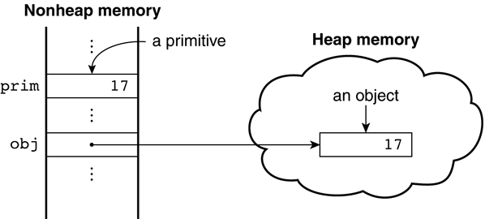
Primitives, Operations, & Expressions
Boolean values are true and false
The only Null value is null
The only Undefined value is undefined
Primitives and objects
Difference between primitives and objects is shown in the above example. Suppose that prim is a primitive variable with the value 17 and obj is a Number object whose property value is 17. Figure shows how prim and obj are stored.

Slide 18
Numeric and String Literals
The numeric values of JavaScript are internally represented in double-precision floating-point , and numeric values are often called numbers
72 7.2 .72 72. 7e2 .7e2 7.e2 7.2E-2
Floating point literals can have decimal or exponent or both
Exponent are specified in uppercase or lowercase e and a possibly integer literal
A string literal Delimited by single quote(‘) or double quote(“)
All string literals are primitive values
Not an array of characters
Escape characters require backslash(\) e.g. \t
Examples:
“We’re in class”, or ‘We\’re in class’

Slide 19
Code | Outputs
' | single quote
" | double quote
& | Ampersand
\\ | Backslash
\n | new line
\r | carriage return
\t | Tab
\b | Backspace
\f | form feed lists other pages on the Web where you can find additional information

Slide 20
Variables
Identifier form:
Begin with letter or underscore
Followed by any number of letters, underscores, digits
Not Case sensitive
Dynamically typed
JavaScript is dynamically typed – any variable can be used for anything (primitive value or reference to any object)
Any variable can be used for anything
Example dynamic-variable.html
The interpreter determines the type of a particular occurrence of a variable

Slide 21
Variables can be either implicitly or explicitly declared
var sum = 0, today = "Monday“, flag = false;
Variable scoping var-scope.html
Local in function when declared with var
Without var it becomes global
Assignment operators
=, or variations such as +=, -=, *=, /= etc.

Slide 22
Numeric operators
++, --, +, -, *, /, %
All numeric operations are done in double precision floating point
Same precedence and associativity as Java
Associativity
when multiple operators have same precedence in single statement; How we evaluate that !
Example
5 * 2 + 1;
12 / 6 / 2;
Associativity.html
Increment/decrement operator (++a) * 3 or (a++) * 3
Placement of these affects computation

Slide 23
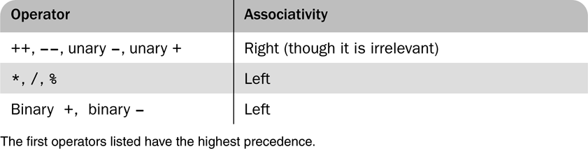
Precedence and associativity of the numeric operators

Slide 24
Math Object
The Math Object provides trigonometric function such as
trig.
sin (sine)
cos (cosine) e.g., Math.cos(x)
floor(truncate the number)
round
max
min
Math.PI;
Math.round()
Math.pow(8, 2); // returns 64
Math.sqrt(64); // returns 8
Math.abs(-4.7);

Slide 25
Math.floor
The floor() method rounds a number DOWNWARDS to the nearest integer, and returns the result.
<script type="text/javascript"> document.write(Math.floor(0.60) + "<br />"); document.write(Math.floor(0.40) + "<br />"); document.write(Math.floor(5) + "<br />"); document.write(Math.floor(5.1) + "<br />"); document.write(Math.floor(-5.1) + "<br />"); document.write(Math.floor(-5.9)); </script>
The output of the code above will be: 0 0 5 5 -6 -6

Slide 26
Random
<html> <body>
<script type="text/javascript">
var r=Math.random()
if (r>0.5) {
document.write("<a href='http://www.pes.edu'>Update Your Bookmarks!</a>“); }
else{
document.write("<a href='http://www.refsnesdata.no'>Visit Refsnes Data!</a>"); }
</script> </body> </html>
Rand.html random.html rand_num.html
Random function returns a random number between 0 (inclusive) and 1 (exclusive).
Output http://www.pes.edu Update Your Bookmarks !

Slide 27
Try This
Develop and demonstrate using JavaScript, a HTML document that displays random numbers (double).
Take lower and upper limit
With function and without function

Slide 28
Primitives, Operations, & Expressions...
Scenarios for explicit conversion
Two integers are in the form
“3” + “4” ---> “34”
Order of operands make the difference
3 + 4 + “xyz” ---> “7xyz”
“xyz” + 3 + 4 ---> “xyz34”
String to number conversion
Use parseInt and parseFloat
parseInt(“34”) ---> 34
parseInt(“34xyz”) ---> 34
parseFloat(“3.4xyz”) ---> 3.4
parseInt(“xyz34”) ---> NaN
Example str-to-num.html //user input/prompt
str-to-num.html // hardcoded, operators -, *, /

Slide 29
parseInt
The parseInt() function parses a string and returns an integer.
<script type="text/javascript"> document.write(parseInt("10") + "<br />"); document.write(parseInt("10.33") + "<br />"); document.write(parseInt("34 45 66") + "<br />"); document.write(parseInt(" 60 ") + "<br />"); document.write(parseInt("40 years") + "<br />"); document.write(parseInt("He was 40") + "<br />"); </script>
O/p:10 10 34 60 40 NaN

Slide 30
NaN
NaN : Not a Number E.g. isNaN() (Devide by Zero error)
An arithmetic operation that creates overflow returns NaN
NaN is not == to any number, not even itself
Number object has the method, toString
Conversions from strings to numbers that do not work return NaN
Not a number
when number computation fails e.g. Overflow
Not == to any number, not even to itself
Test it with isNaN(x)
isNan.html

Slide 31
String Catenation (Implicit / Explicit)
With + operator Catenation
Mixing of number and string
Strings to number when operator is not +
Returns NaN when coercion fails
E.g. – Let say value of first is Freddie
So we write “ Freddie Freeloader” as first + “Freeloader”
Implicit Type (coercions): Value of one type is used in a position that requires a value of different type
“August “ + 2010 represent: August 2010
Explicit Type: String that contains number that can be converted to number with string constructor
var str_value = String(value);
var num =6;
var str_value = num.toString();
var str_value_binary = num.toString(2);
First conversion gives the values 6 and Second gives 110

Slide 32
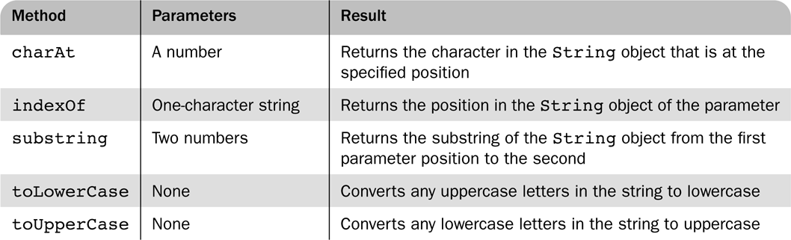
String methods

Slide 33
String properties and methods
var str = “George”; var len = str.length;
String methods:
charAt: returns characters of a specific position
IndexOf: Returs position of the character
Substring
toLowerCase
toUpperCase
str.charAt(2) is ?
str. Indexof(‘r’) is ?
str.substring(2, 4) is ?
str.toLowerCase() is ?
‘o’
3
‘org’
‘george’

Slide 34
typeof operator
Returns one of the following
“number”
“string”
“boolean”
“undefined”
“function”
“object”
null
Example: typeof(x)
var myvar=5
alert(typeof myvar) //alerts "number"

Slide 35
JavaScript Date Object
Return today's date and time
<html>
<body>
<script type="text/javascript">
document.write(Date());
</script>
</body>
</html>
Example
var myDate=new Date() myDate.setFullYear(2013,07,11) myDate.setDate(myDate.getDate()+5)

Slide 36
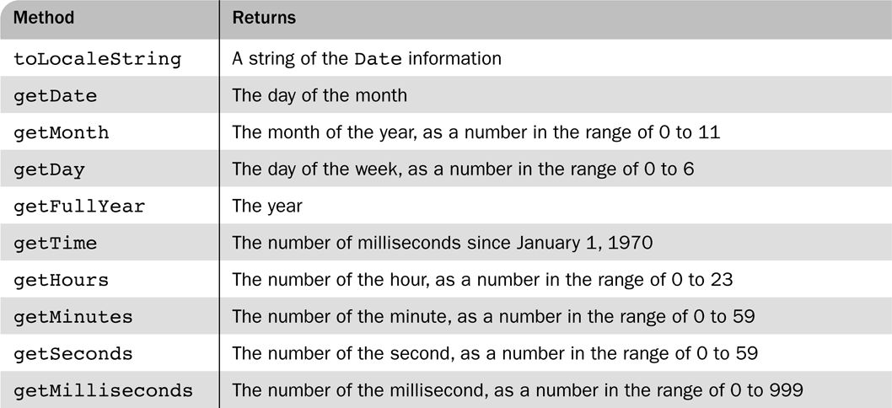
Date Object
Created with Date constructor (no params)
Local time methods of Date
toDateString - date value in current time zone
toTimeString - time value in string HH:MM:SS timezone

Slide 37
Date Object Digital Clock
Date setting methods
setDate(), setMonth(), setFullYear()
setHours(), setMinutes(), setSeconds()
Example 1
var myDate = new Date(‘1 Jan 2017’);
myDate.setDate(10);
Sets date to 10th Jan
myDate.setDate(33);
Sets date to 2nd Feb.
myDate.setMonth(13);
Sets it February of next year
Example 2
var now = new Date(); // gets today’s date
var curday = now.getDate();
now.setDate(curday + 30);// sets 30 days from today.

Slide 38
Constructor and Prototype
Property | Description
constructor | A reference to the function that created the object
prototype | Allows you to add properties and methods to the object

Slide 39
Constructor
<script>
function employee(name,jobtitle,born)
{
this.name=name;
this.jobtitle=jobtitle;
this.born=born;
}
var fred=new employee("Fred Flintstone", "Postman",1970);
document.write(fred.constructor);
</script>
The output of the code above will be:
function employee(name, jobtitle, born) {this.name = name; this.jobtitle = jobtitle; this.born = born;}

Slide 40

Screen Output & Keyboard Input
The JavaScript models the HTML document with the Document object
The model for the browser display the window is the Window object
The Window object has two properties, document and window, which refer to the Document and Window objects, respectively
The Document object has a method, write, which dynamically creates content
The parameter is a string, some of which are variables
e.g., document.write(“The result is: " + result +"<br />");
The parameter is sent to the browser, so it can be anything that can appear in an HTML document (<br />)

Slide 41
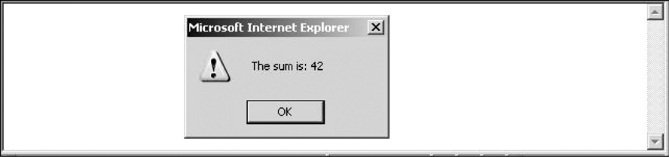
Dialog window
The Window object has three methods for creating dialog boxes,
alert, confirm, and prompt
alert("Hey! \n");
Parameter is plain text, not HTML
Opens a dialog box which displays the parameter string and an OK button
It waits for the user to press the OK button
alert (“The sum is “ + sum + “\n”);

Slide 42
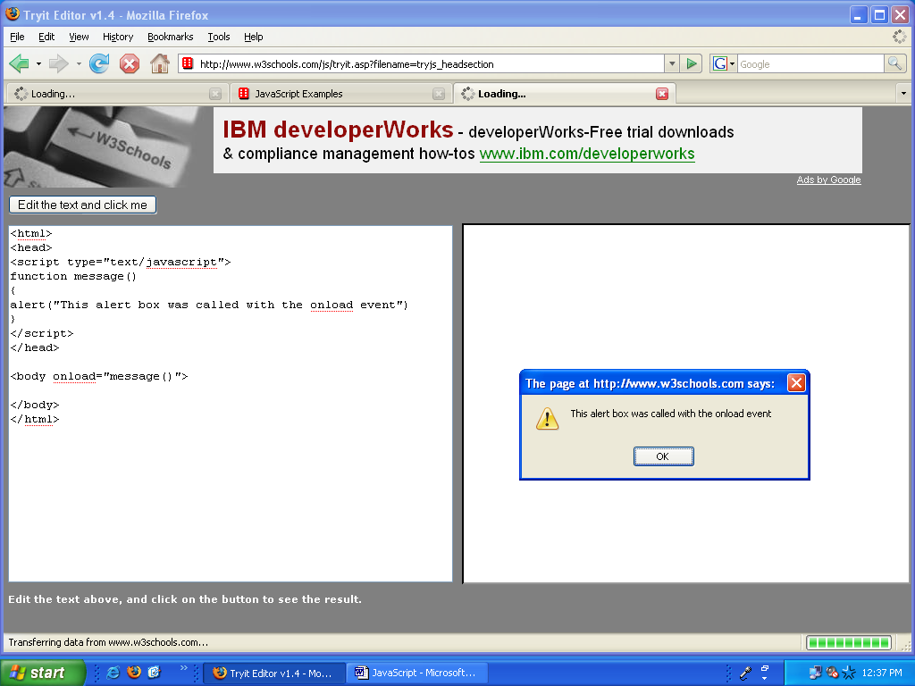
Alert window
<html>
<head>
<script type="text/javascript">
function message(){
alert("This alert box was called with the onload event");}
</script>
</head>
<body onload="message()">
</body>
</html>

Slide 43
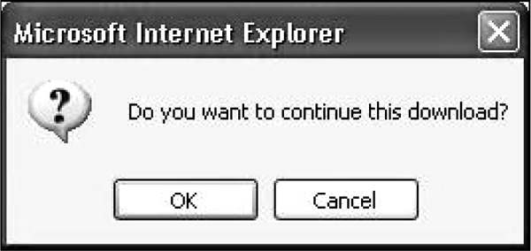
Confirm dialog box
2. confirm("Do you want to continue?");
Opens a dialog box and displays the parameter and two buttons, OK and Cancel
Returns a Boolean value, depending on which button was pressed (it waits for one)
var question = confirm (“ Do you want to continue ?”);
Example

Slide 44
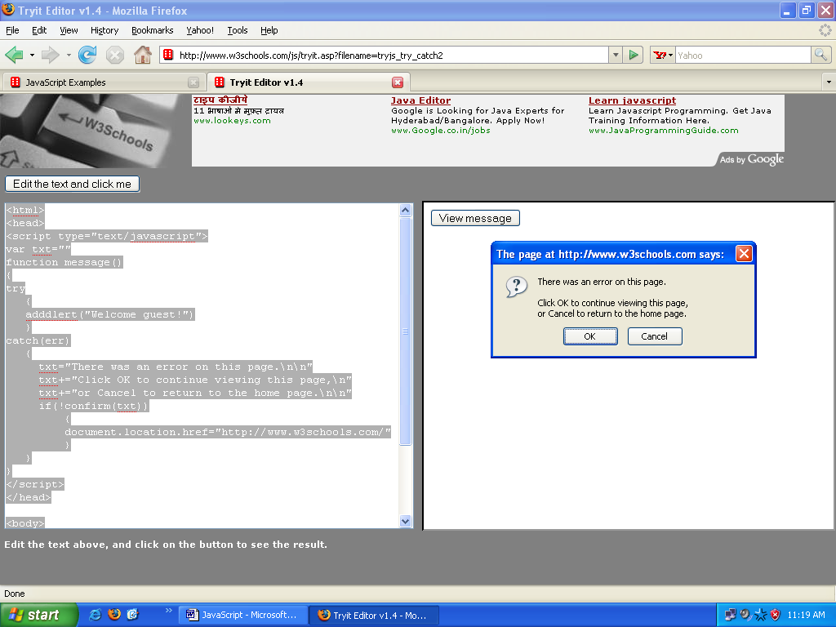
Confirm Window
<!DOCTYPE html>
<html><head>
<script type="text/javascript">
var txt=" ";
function message()
{try { adddlert("Welcome guest!"); }
catch(err)
{ txt="There was an error on this page.\n\n";
txt+="Click OK to continue viewing this page,\n";
txt+="or Cancel to return to the home page.\n\n";
if(!confirm(txt)) {document.location.href=http://www.pes.edu/;}
} }</script> </head><body><input type="button" value="view message" onclick="message()">
</body> </html>

Slide 45
Simple confirm
Confirm with try-catch block
Try-Catch-Throw

Slide 46
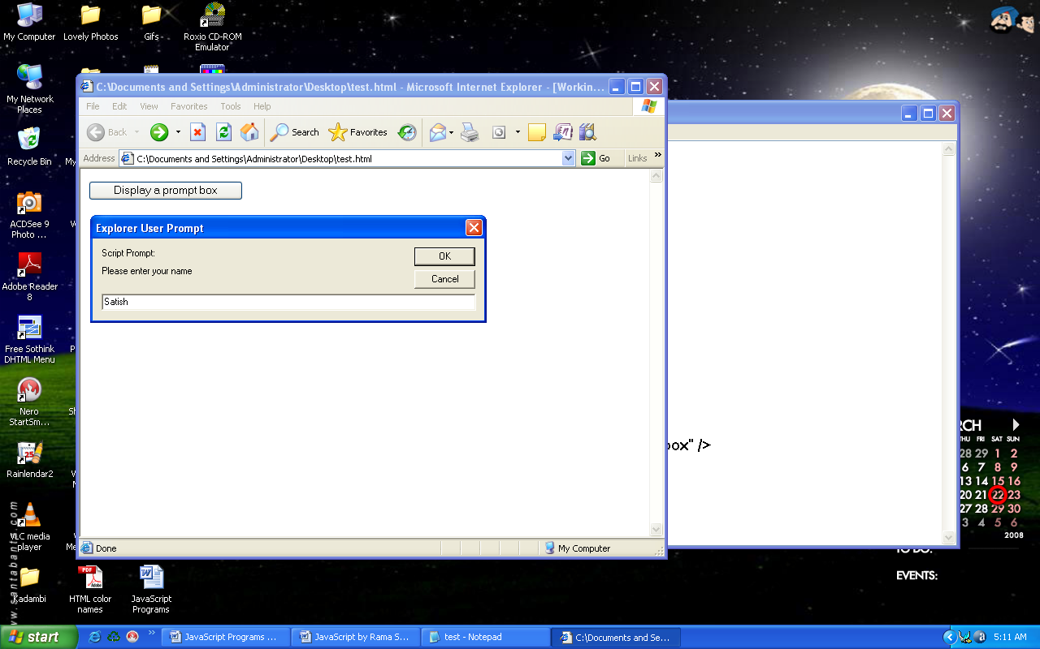
Prompt window

Slide 47
3. prompt("What is your name?", "");
Opens a dialog box and displays its string parameter, along with a text box and two buttons, OK and Cancel
The second parameter is for a default response if the user presses OK without typing a response in the text box (waits for OK)
name = prompt (“What is your name? “, “ “);
roots.html root.js
Story

Slide 48
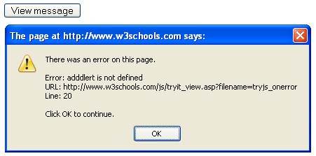
Error Console
Represent error in the Script
Error Box
<html> <head>
<script type="text/javascript">
onerror=handleErr();
var txt=" ";
function handleErr(msg,url,l) {
txt="There was an error on this page";
txt+="Error: " + msg + "\n";
txt+="URL: " + url + "\n";
txt+="Line: " + l + "\n\n";
txt+="Click OK to continue ";
alert(txt)
return true; }
function message()
{
adddlert("Welcome guest! ");
}
</script></head>
</html>

Slide 49
Loop statements
while (control_expression) statement or compound statement
Example(Insert_names) Insert.js
for (initial exp.; control exp; increment exp.)
statement or compound statement
Initial expression can have declarations, but the scope of such variables is the whole script
do
statement or compound statement
while (control_expression)
break and continue statements
Used for affecting execution flow

Slide 50
Control Statements
Similar to C, Java, and C++
Compound statements are delimited by braces
Control expressions – three kinds
1. Primitive values
If it is a string, it is true unless it is empty or "0”
If it is a number, it is true unless it is zero
2. Relational Expressions
The usual six: ==, !=, <, >, <=, >=
Operands are coerced if necessary
If one is a string and one is a number, it attempts to convert the string to a number
If one is Boolean and the other is not, the Boolean operand is coerced to a number(1 or 0)

Slide 51
3. Compound Expressions
The usual operators: &&, ||, and !
The Boolean object has a method, toString, to allow them to be printed (true or false)
Selection Statements
The usual if-then-else (clauses can be either single statements or compound statements)
Evaluation is to the needed value
Cond1 && con2d
If cond1 is false cond2 is not evaluated
cond1 || cond2
If cond1 is true cond2 is not evaluated
Boolean object is false if it is null or undefined

Slide 52
Logical Operators
Operator | Description | Example
&& | and | x=6 y=3 (x < 10 && y > 1) returns true
|| | or | x=6 y=3 (x==5 || y==5) returns false
! | not | x=6 y=3 !(x==y) returns true

Slide 53
Assignment Operators
Operator | Example | Is The Same As
= | x=y | x=y
+= | x+=y | x=x+y
-= | x-=y | x=x-y
*= | x*=y | x=x*y
/= | x/=y | x=x/y
%= | x%=y | x=x%y

Slide 54
The unusual two: === and !==
Same as == and !=, except that no coercions (The act of compelling by force) are done (operands must be identical).
Comparisons of references to objects are not useful (addresses are compared, not values).
var-scope.html
Date_ Formatted .html

Slide 55
Comparison Operators
Operator | Description | Example
== | is equal to | 5==8 returns false
=== | is equal to (checks for both value and type) | x=5 y="5" x==y returns true x===y returns false
!= | is not equal | 5!=8 returns true
> | is greater than | 5>8 returns false
< | is less than | 5<8 returns true
>= | is greater than or equal to | 5>=8 returns false
<= | is less than or equal to | 5<=8 returns true

Slide 56
switch statement
Test expression can be number, string or boolean
Case statement can be compound or statement sequences
Can combine at least two case statements
The break and default as the last statement
switch (expression) {
case value_1:
// value_1 statements
case value_2:
// value_2 statements
…
[default:
// default statements]
}

Slide 57
Switch
The statements can be either statement sequences or compound statements
The control expression can be a number, a string, or a Boolean
Different cases can have values of different types
borders2.html border2.js

Slide 58
Arrays
Variable holding more than one data element
Index starts from 0
Data elements needs not be of same type
No size limit except system memory
JavaScript array has dynamic length: Max 2³²
Array can assign to non-existent element
var arr = new Array(10);
arr[15] = “PESIT”;
Creates 16th array element by increasing array length
First 15 elements are undefined.

Slide 59
Array creation (two ways)
1. new operator
var arr = new Array();
var arr = new array() will not work
var arr = new Array(100);
Var list = new Array(1, 2,“three”, “four”);
Array objects
var arr = [“MCA”, 60, “Sec A”, 57];
arr[0] = “MCA”;
arr[1] = 60;
arr[2] = “Sec A”;
arr[3] = 57;

Slide 60
Arrays
Multi dimensional arrays
Done by creating array inside another array
var student = new Array();
student[0] = new Array()
student[0][0] = “1PI16MCA01”;
student[0][1]= “Kavya”;
student[1] = new Array();
student[1][0] = “1PT17MCA60”;
student[1][1]= “Rahul”;
Example: arrays.html median.html median.js

Slide 61
Array Object
Length is dynamic
Denoted by length property
Stores the length
Can be modified to change the length
Creation of array object
Using new
var students = new Array(60);
Assigning array literals
var depts = [“MCA”, “CSE”, “Telecom”];
Elements index starts from 0
Length = highest subscript + 1
Assignment to non-existent element creates the element
Example insert_names.html insert_names.js

Slide 62
Arrays...
Methods (join, reverse, sort, concat, slice, toString)
join
var liststr = list.join(“ : “);
var liststr = list.join(“<br />“);
reverse
Reverses the elements in array
concat
Joins two arrays
var names = new Array(‘usn01’,‘usn02’);
var ages = new Array(21, 22);
var newarr = names.concat(ages);
Gives (‘usn01’, ‘usn02’, 21, 22)

Slide 63
Arrays...
slice
Creates sub-array between the two indexes specified
Default for 2nd index is the last index
list.slice(2,5);
list.slice(2);
toString
Convert elements to strings, if necessary
Catenates the elements together
Separated by comma(,)
Much like join

Slide 64
Sort function - comparison
sort
By default, sorts alphabetically
list.sort();
To sort differently, provide comparison operator
list.sort(function cmp(a,b)
{return a-b;});
Comparison function for sort
Provide your comparison logic
Return value is used for sort order
-ve : sort order is ok
0: items are equal
+ve: sort order is not ok, reverse the items
Example:
median.html median.js

Slide 65
Arrays...
push
Adds the element in the end
list.push(item);
pop
Removes the last element
List.pop();
shift
Removes the first element
list.shift();
unshift
Adds element before first element
list.unshift(“item”);
Example
nested_arrays.html nested_arrays_avg.html

Slide 66
Functions
Something that performs specific task
Encapsulate a block of code
Provides reusable code
Built-in function examples
parseInt(), parseFloat(), isNaN()
function function_name([formal params]) {...body...}
Return value
Parameter of return
undefined if no parameter
If no return, then undefined
All function definition should be placed in <head>
All variables declared implicitly are global
Variables declared explicitly inside are local;
{var x;}

Slide 67
Functions...
Parameters are pass by value
Reference variables semantically work as pass-by-reference
No type checking for parameters
No check for number of parameters
Excess passed parameters are ignored
Excess formal parameters are set to undefined
All parameters are sent in arguments array
Property length provides count of parameters
Example:
params.html params.js

Slide 68
Object Creation and Modification
Created with new
var obj = new Object();
New object is always a blank object
No properties/methods at creation time
Properties can be added dynamically
Anytime during the object existence
Could be another object i.e. Nested objects
Properties are accessed with dot notation or with property name
var class = new Object();
class.name = “Web Programming”;
class.teacher = new Object();
class.teacher.name = “Tamal Dey”;
delete property by: delete teacher.name;

Slide 69
Constructors
Used for initialization
Actually create the properties
Generally have assignment properties
function Plane(newMake, newModel, newYear){
this.make = newMake;
this.model = newModel;
this.year = newYear;
}
var p = new Plane(“Boeing”, “777”, 1997);
The following line must be added to car constructor
this.display=plane;

Slide 70
Pattern Matching using Regular Expression
Pattern matching in Java Script can be done in two ways
With RegExp object
With String object
Patterns are based on regular expression which are developed to define member of a simple class of formal languages
Patterns are sent as parameters to the pattern matching method and delimited with slashes [ /……./ ]
Simplest pattern matching method is search which takes pattern as a parameter. Search method returns the position of the string object when pattern matched . If no match returns -1

Slide 71
var str = “Rabbits are beautiful”;
var position = str.search ( / bits / );
if ( position > 0 )
document.write(“’bits’ appear in position”, position,< br />”);
else
document.write(“’bits’ does not appear in str < br />”);
O/P
‘bits’ appears in position 4

Slide 72
Character and Character-Class Patterns
Normal characters are those that are not metacharacters
Metacharcters have special meaning in context of patterns
\ | ( ) [ ] { } ^ $ * + ? .
To match a period match any character except newline
/ snow./ matches “snowry”, “snowe” and “snowd”
Metacharacter can be matched by preceded by
The pattern /3\.4/ matches 3.4
The pattern /3.4/ match 3.4 and 374

Slide 73
Character class
Character class matches ‘a’, ‘b’ , ‘c’ with [abc]
Dashes can appear in class definition.
[a-h] matches any lowercase character letter from ‘a’ to ‘h’
Circumflex character (^) inverts the specified set
[^aeiou] matches any character except ‘a’, ‘e’, ‘i’ , ‘o’ , ‘u’ they are frequently used
Only matches beginning of a string
/^The/ matches “The” in “The night” by not “In The Night”
To match at the end of a string $ sign is used
/gold$/ match “ I like gold” but does not match “goldern”

Slide 74
Predefined character classes
Name Equivalent Pattern Matches
\d [0-9] A digit
\D [^0-9] Not a digit
\w [A-Za-z_0-9] A word Character(alphanumeric)
\W [^A-Za-z_0-9] Not a word digit
\s [\t \n] A white space character
\S [^\t \n] Not a white space character
/\d\.\d\d/ //Matches a digit followed by a period followed by two digits
/\D\d\D/ // Matches a single digit
/\w\w\w/ //Matches three adjacent word characters

Slide 75
To repeat a part of pattern we use a numeric quantifier, delimited by braces. Eg.- xyyyyz matches by /xy{4}z/
Three symbolic quantifiers:
Asterisk (*) : Means zero or more repetitions of characters
Plus (+) : Means one or more repetition of characters
Question mark (?) : Means one or none match
/x*y+z?/
This pattern matches a string begin with any number of x’s (including zero), followed by one or more y’s possibly followed by z

Slide 76
/\d+\.\d*/
/[A-Za-z\w*]
\bt[a-z]+\b

Slide 77
5. a) Develop and demonstrate, using JavaScript script, a XHTML document that collects the USN ( the valid format is: A digit from 1 to 4 followed by two upper-case characters followed by two digits followed by two upper-case characters followed by three digits; no embedded spaces allowed) of the user. Event handler must be included for the form element that collects this information to validate the input. Messages in the alert windows must be produced when errors are detected.
b) Modify the above program to get the current semester also (restricted to be a number from 1 to 6.

Slide 78
Color | Color HEX | Color RGB
 | #000000 | rgb(0,0,0)
 | #FF0000 | rgb(255,0,0)
 | #00FF00 | rgb(0,255,0)
 | #0000FF | rgb(0,0,255)
 | #FFFF00 | rgb(255,255,0)
 | #00FFFF | rgb(0,255,255)
 | #FF00FF | rgb(255,0,255)
 | #C0C0C0 | rgb(192,192,192)
 | #FFFFFF | rgb(255,255,255)
HTML colors can be defined as a hexadecimal notation for the combination of Red, Green, and Blue color values (RGB).
The lowest value that can be given to one light source is 0 (hex #00) and the highest value is 255 (hex #FF).

Slide 79

Questions !!!

